Slide 1
Angular
Data Binding, Directives, and Pipes
Lecture 3
By James(Jin) Wang
09/01/2019

Slide 2
Outline
ES Module
Angular Modules
Components
Templates
Metadata

Slide 3
ES Modules
  We assemble our application from modules.
  A module exports an asset such as a Service, Component, or a shared value

Slide 4
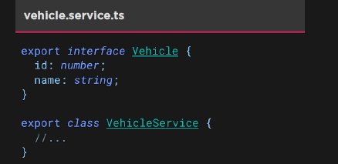
ES Modules
  Exporting modules:
  We assemble our application from modules.
  A module exports an asset such as a Service, Component, or a shared value

Slide 5
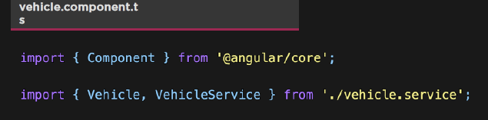
ES Modules
  Importing modules:
  Modules and their contents can be imported using the import keyword
  We import the Vehicle and VehicleService using destructuring

Slide 6
Angular Modules
  We use NgModule to organize our application into cohesive block of related functionality

Slide 7
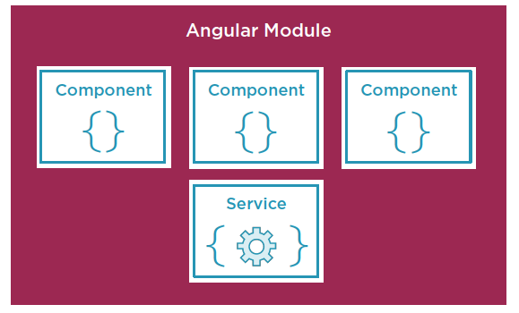
Angular Modules
  Angular Modules Organize Functionality:

Slide 8
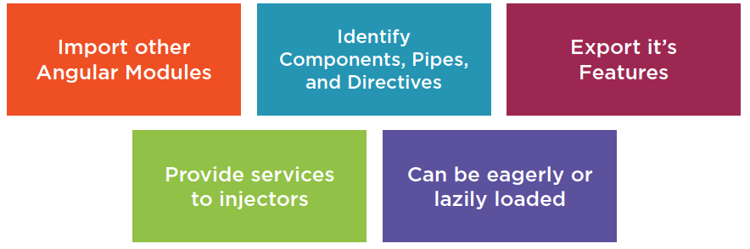
Angular Modules
  Roles of Angular Modules:

Slide 9
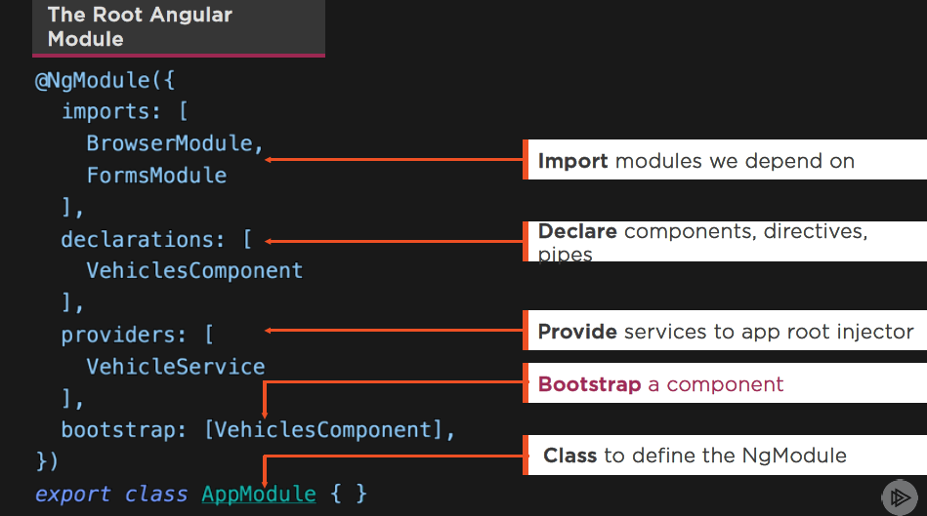
Angular Modules

Slide 10
Components
  A Component contains application logic that controls a region of the user interface that we call a view

Slide 11
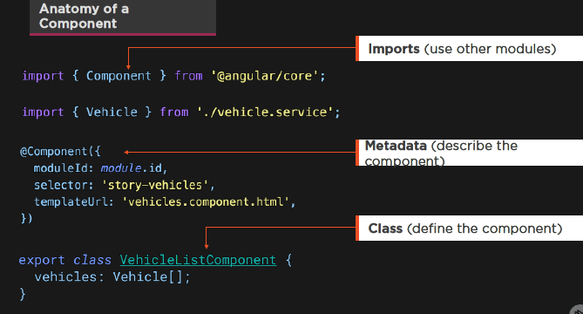
Components

Slide 12
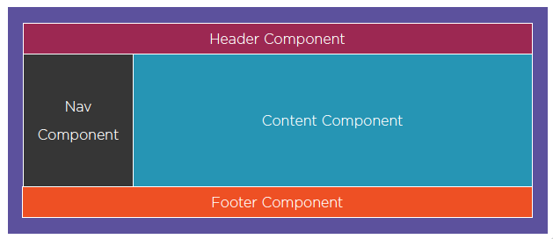
Components
  Assembling Our App from Components:

Slide 13
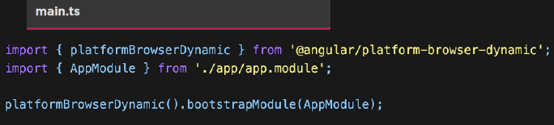
Components
  Bootstrapping a Component:
  Entry point for the app
  This is where we start

Slide 14
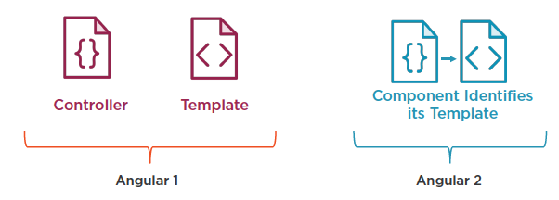
Components
  Comparing Angular 1 to Angular 2+:

Slide 15
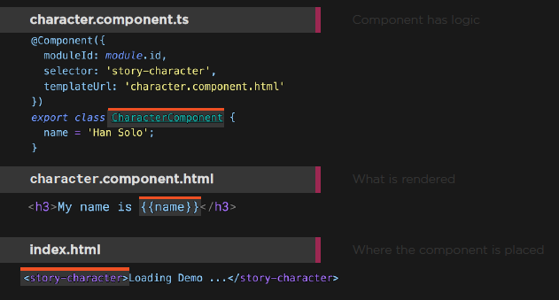
Components

Slide 16
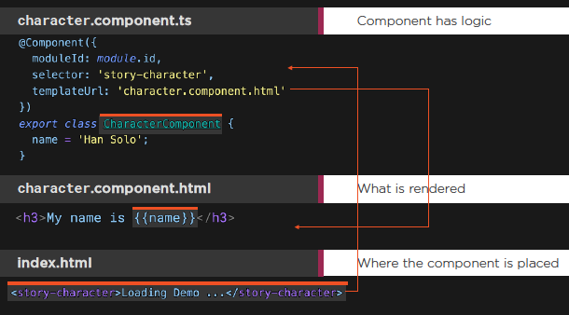
Components
  Demo: Components

Slide 17
Templates
  Templates are the View:
  Templates are mostly HTML, with a little help from Angular. They tell Angular how to render the Component.

Slide 18
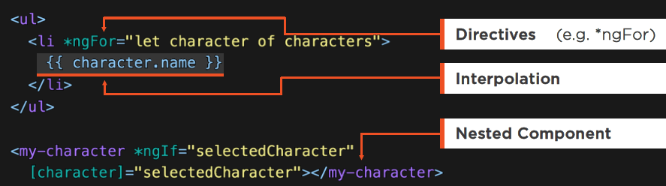
Templates
  Templates:
  HTML
  Directives, as needed
  Template Binding Syntax

Slide 19
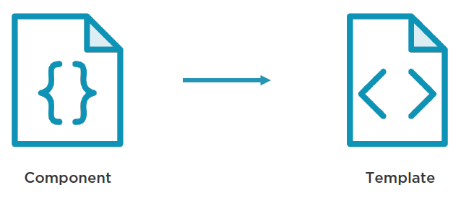
Templates
  Connecting the Component to its Template:

Slide 20
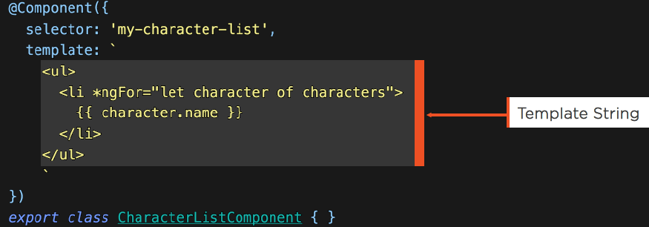
Templates
  Inline Templates:
  Template defines an embedded template string
  Use back-ticks for multi-line strings

Slide 21
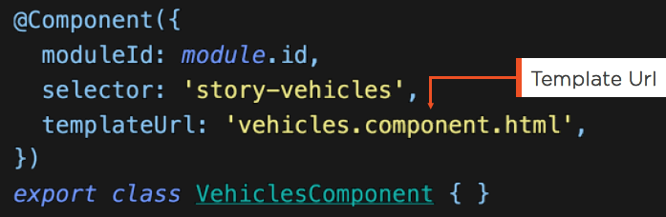
Templates
  Linked Templates:
  templateUrl links the Component to its Template

Slide 22
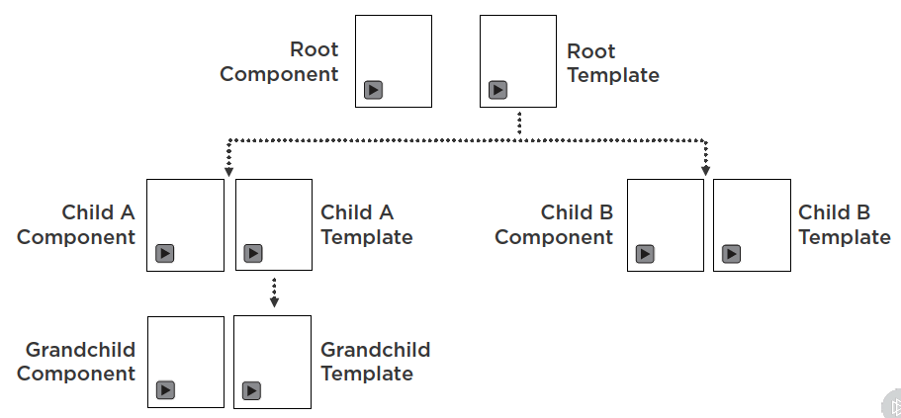
Templates
  Templates Contain Other Components:
  Demo: Nested Components

Slide 23
Metadata
  Metadata:
  We use Metadata to tell Angular about the objects we build.

Slide 24
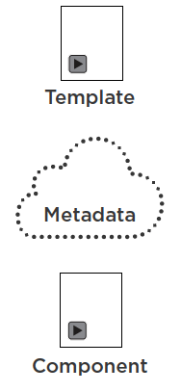
Metadata
  Metadata Links the Template to the Component:

Slide 25
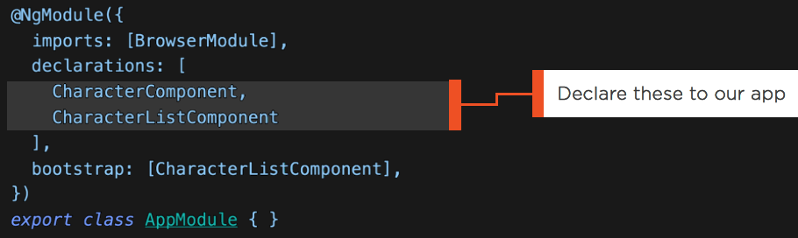
Metadata
  Declaring Components:
  BrowserModule includes CommonModule
  Built-in directives like *ngFor and ngClass are in CommonModule
  We tell Angular what <my-character-list> and <my-character> are

Slide 26
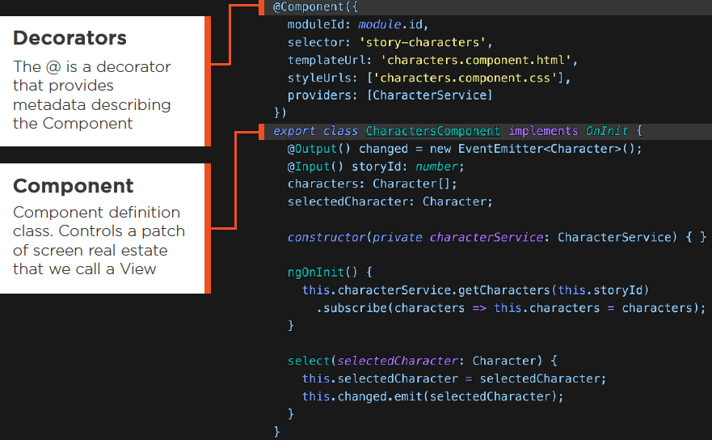
Metadata

Slide 27
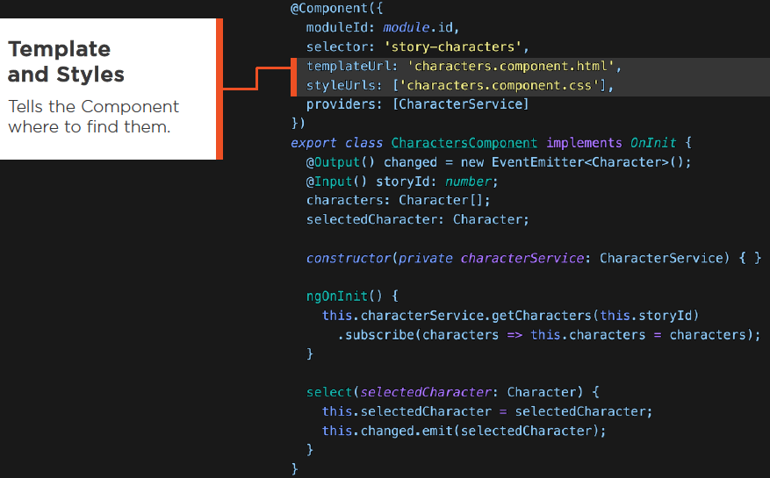
Metadata

Slide 28
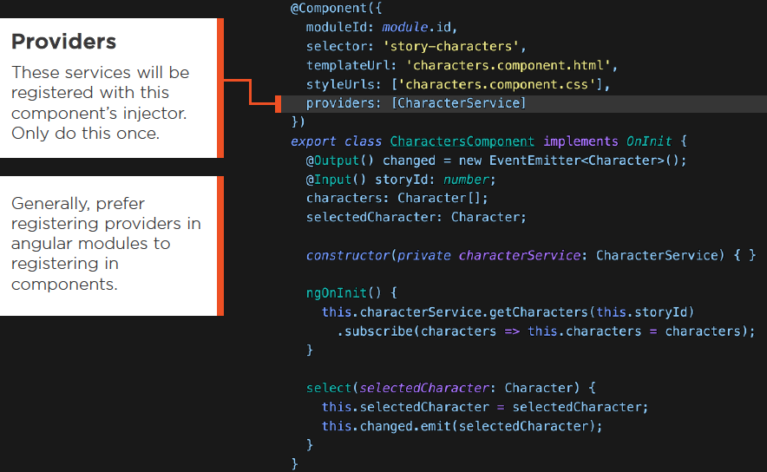
Metadata

Slide 29
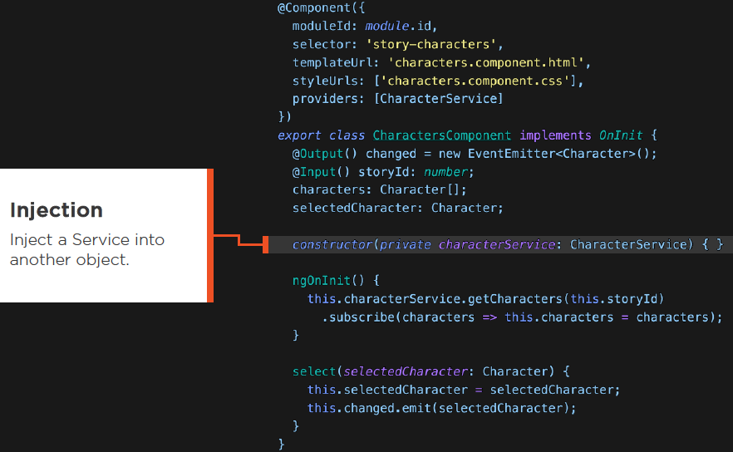
Metadata

Slide 30
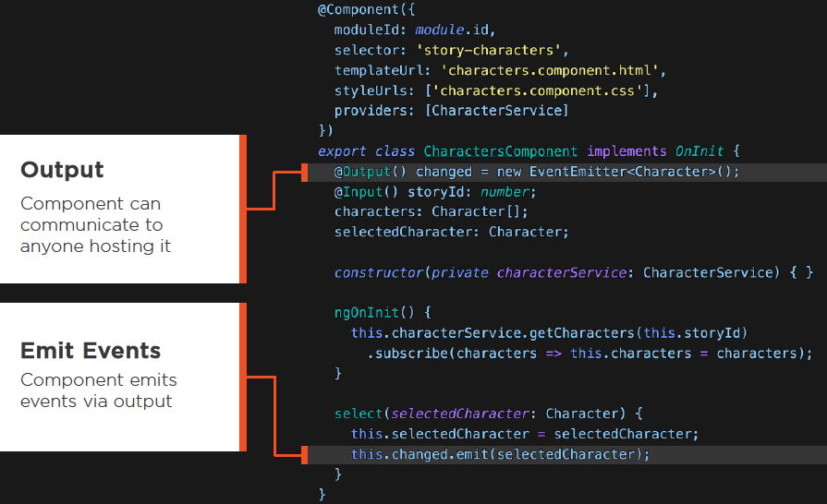
Metadata

Slide 31
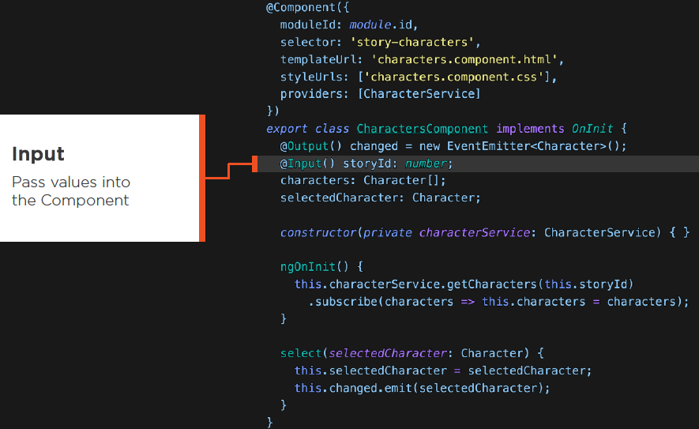
Metadata

Slide 32
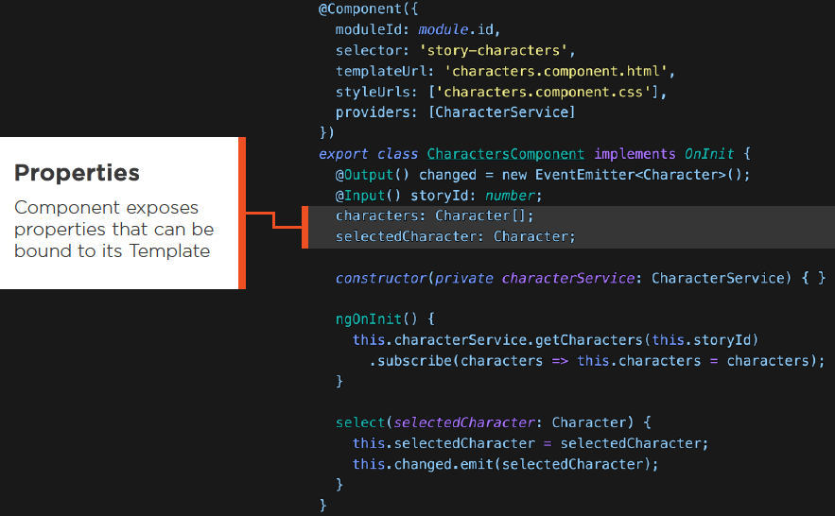
Metadata

Slide 33
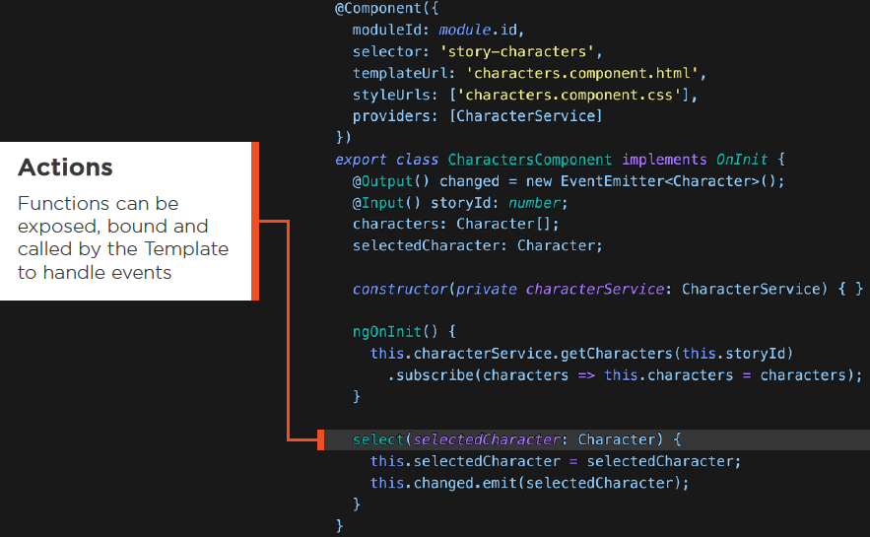
Metadata

Slide 34
Input and Output
  Input and Output:
  Components allow input properties to flow in, while output events allow a child Component to communicate with a parent Component.

Slide 35
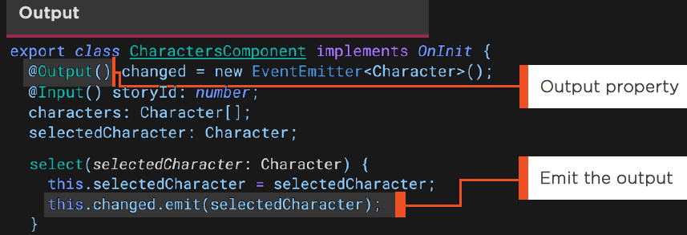
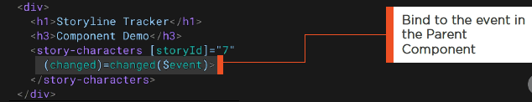
Input and Output

Slide 36
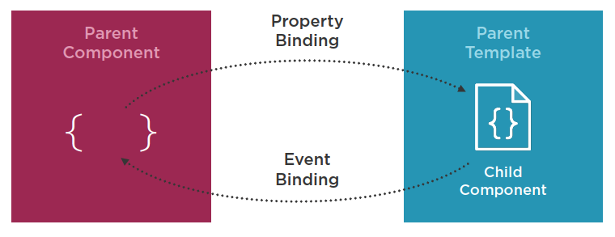
Input and Output
  Demo: Input / Output Components

Slide 37
ViewChild
  ViewChild:
  Use ViewChild when a parent Component needs to access a member of its child Component.

Slide 38
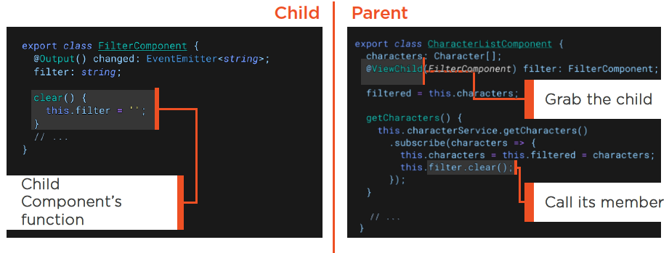
ViewChild

Slide 39
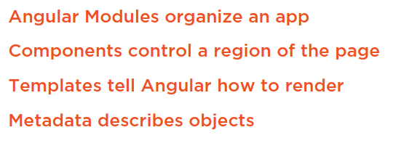
Summary

